Slide 1
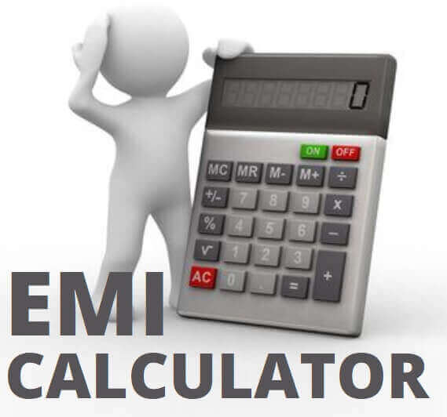
TOPIC : EMI CALCULATOR
IDEA:One and Only source to calculate EMI’s
It’s an EMI world. Whenever we talk about loans, the first thing that crosses the mind is loan EMI calculation. The abbreviation, EMI stands for Equated Monthly Installment.
An equated monthly installment (loan EMI calculation) is the sum that the loan borrower pays every month to repay the money borrowed on a particular date in each calendar month.
The loan amount along with the accrued interest is divided equally over a period which is the loan tenure. The number of loan EMIs is equal to the number of months in the loan repayment tenure.
Formerly, a limited range of products, says personal loans or home loans, and alike loan products were available on EMI. But now the scenario has completely changed. The E-commerce world has now so much to offer.

Slide 2
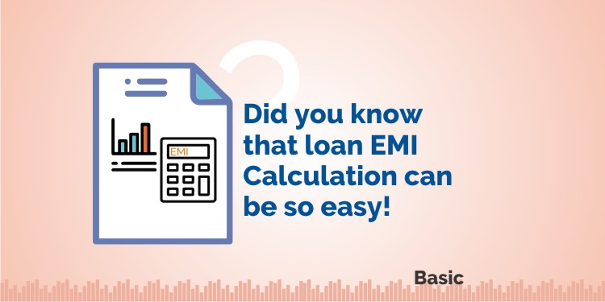
EMI CALCULATOR
Calculate equated monthly installment EMI for home loan ,car loan , housing loan .Use EMI calculator to calculate monthly EMI’s on the basis of loan amount and interest rate.
EMI acronym for Equated monthly installment plays a crucial role in getting a home loan.It is the amount a customer pays every month to the bank or any other financial institutions.
This amount is borne by the customer till the time the loan amount bis not completely paid off.

Slide 3
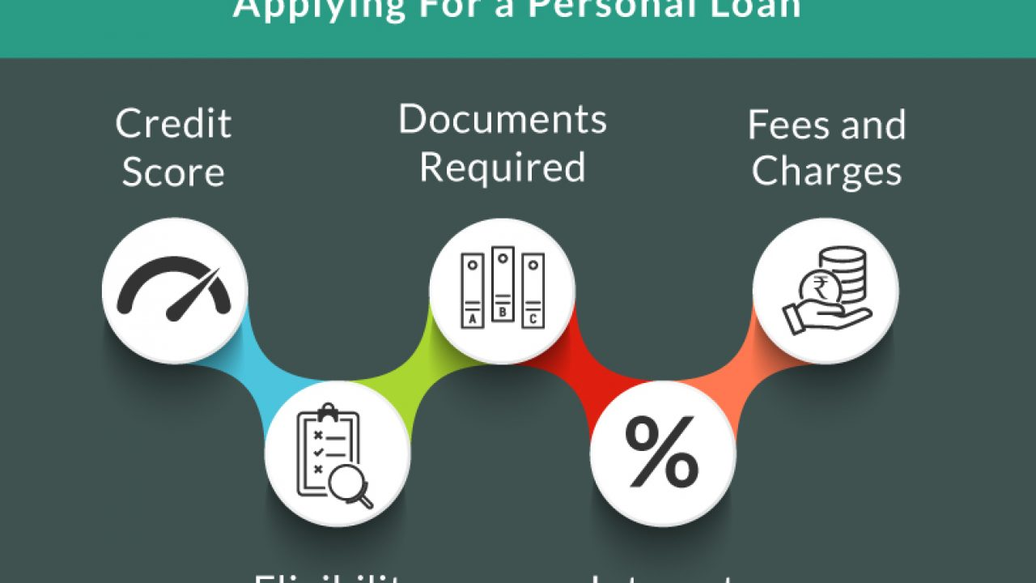
EMI CALCULATOR’S ESSENTIALS
It comprises two essential amounts to be paid:
Principal loan amount and
Interest amount
These are the amounts payable to the bank or financial institution every month

Slide 4

How are EMI’S Calculated ?
A loan tenure for the Longer time say for a maximum period of 30 years helps in cutting down the EMI’s.Its extremely important that you have a sound knowledge of the amount that you need to pay every month towards your EMI.However to get the best estimate you are likely to bear towards EMI’s using a home calculator will be the best.

Slide 5

HOW AN EMI CALCULATOR WORKS ?
LOAN AMOUNT
The loan principal or the actual amount borrowed as a loan for purchasing the house, car, or any other requirement. This loan amount depends upon a number of factors related to the loan applicant and the cost of the purchase
TENURE OF THE LOAN
For example, personal loans are shorter tenure loans up to a maximum of 5 years whereas home loans are longer tenure loans which can go up to a maximum of 25-30 years. The longer the tenure of the loan, the more will be the interest that you will have to pay and thus higher will be the EMIs.
INTEREST AMOUNT
. It is the rate at which the interest is charged on the amount lent to the borrower

Slide 6
TECHNOLOGY STACK
HTML
CSS
JavaScript

Slide 7
Thank you !

